Slide 1
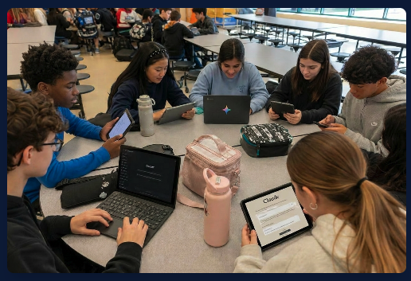

AI is Already in Our Students’ Hands. Are Our Families Ready and Aligned with School Guidelines?
A Simple, High-Impact Way to Support Families & Strengthen School-Home Alignment

Slide 2


Slide for Principal to use with teachers
Why We’re Offering This Event to Our School Families?
Meets a Critical Need
Supports School Goals
Parents are anxious and uncertain about AI. Most don’t know how to support their children’s use of these tools while students are already using them.
This event complements national and state guidance as well as our school’s AI guidance and policy work, helping families understand expectations and reinforcing what we’re building internally.
Promotes Shared Responsibility
Turnkey for Us
Schools can’t do this alone. When families know their role, we create clarity and consistency for students across home and school.
The non-profit event organizer provides all the promotional materials we need. Follow this link to access emails, flyers, and digital content with your families.

Slide 3


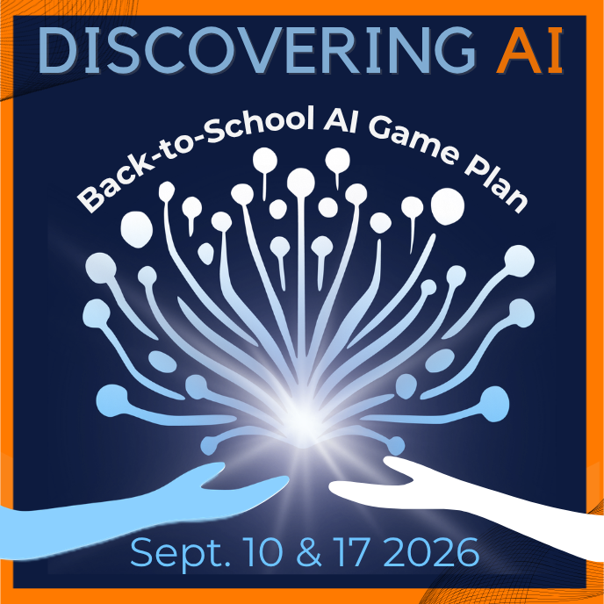
How Event Works & Next Steps
Live virtual event modeled after Night Out - with on-demand access for those who can’t attend live
For Families:
For Schools:
Families register for the free event (shared through the school emails, calendars, and back-to-school events)
You will receive event communication materials to share with your team and school community.
They learn what AI is, how it’s used, and how to responsibly guide their children’s intentional, ethical, and creative use
Share the event with your families in your emails, newsletters, and events
Gain insight into practical strategies, clear boundaries, and guidance to align with school AI guidelines.
Include the flyer and discuss the importance of attending at your Back-to-School night(s)
Promo kit delivered to your inbox!
https://springedu-marketing-materials.discoveringai.org/
Let’s help every family feel supported and every student thrive in the Age of AI.

