Slide 1

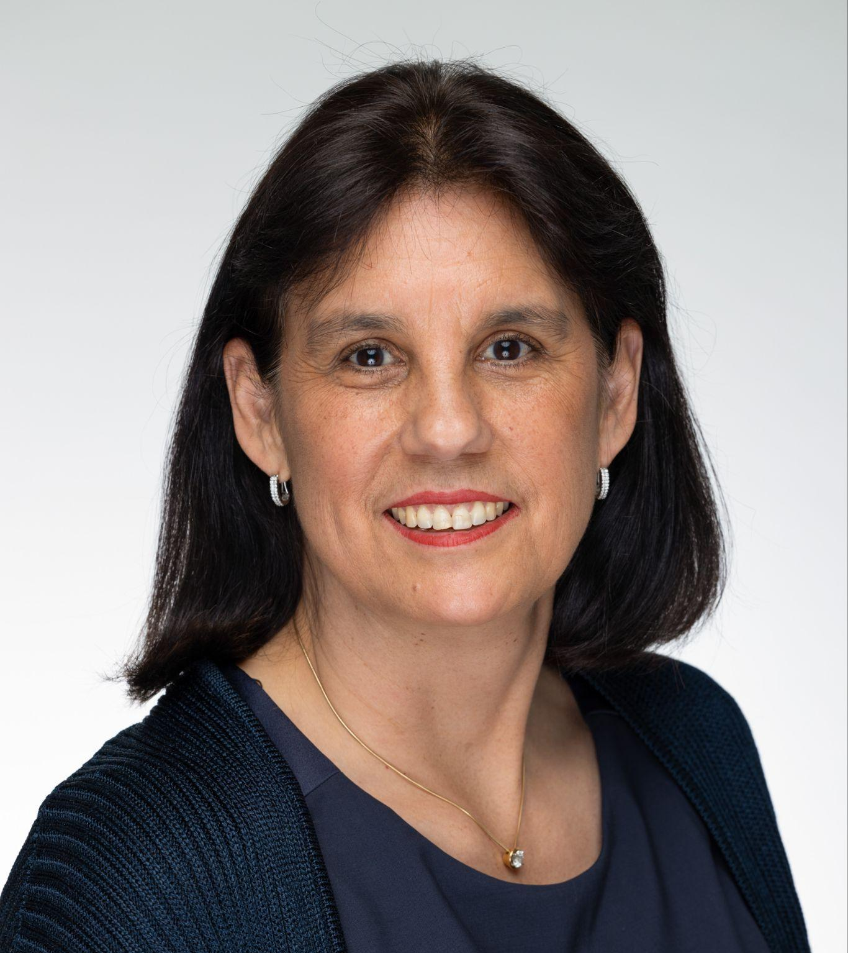
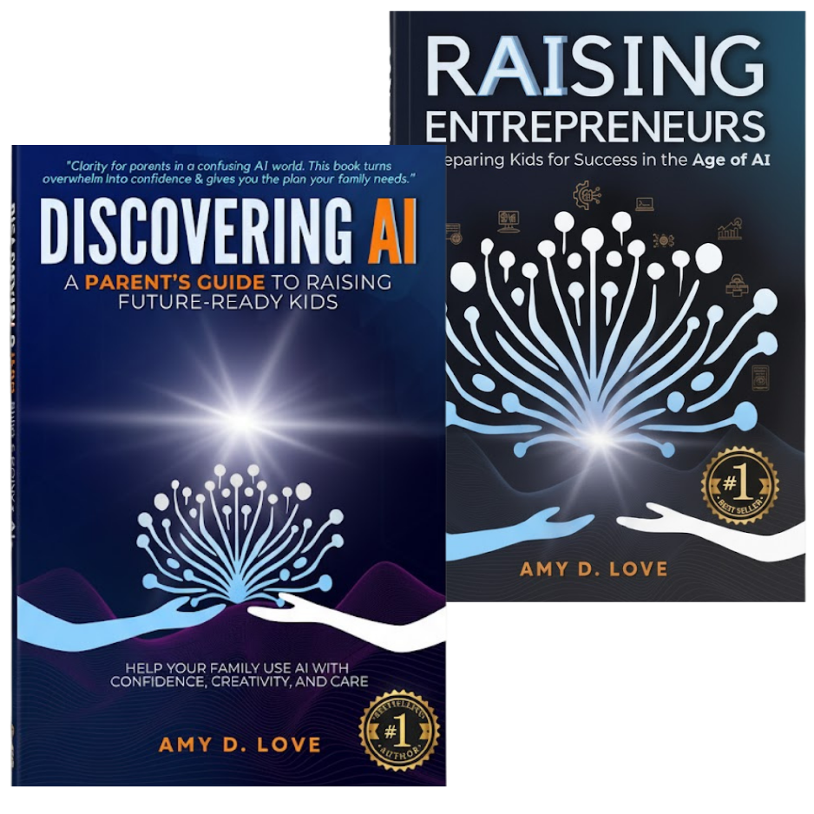
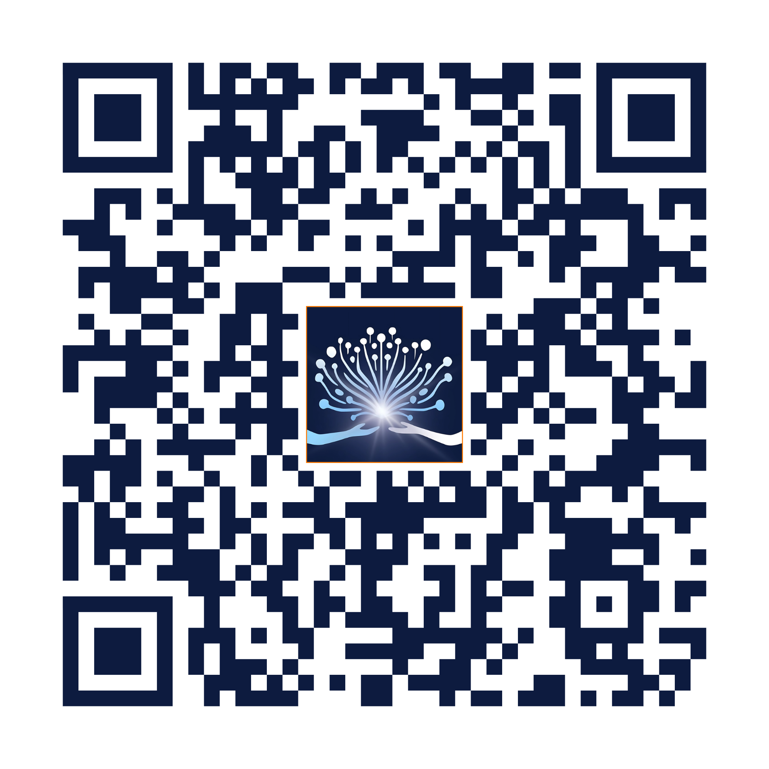
Spring Education Group and [Insert School Name] Invites You to the Two-Part Series:
"Let’s work together to prepare every
student for success in the Age of AI!"
[Insert Principal Name}
Registration is Required. Use the QR Code or https://spring-edu-reg.discoveringai.org/
Join live or watch on demand.
Your attendance is strongly encouraged!
Sessions led by national expert: Amy Love
This Parent Enrichment Program is being sponsored by Spring Education Group and is exclusively open to all Stratford Campus, IK12, and
BASIS Independent Schools.
Notes:
Here’s a concise script the principal can read while showing the slide during Back-to-School Night. It’s warm, direct, and clearly explains what the event is, why it matters, and what parents need to do:
Principal’s Script for Back-to-School Night Slide:
“Before we wrap up, I want to personally invite every family to a special event we’re supporting this year.. the Annual National Back-to-School AI Game Plan event
This is more than just a webinar. It’s a practical, parent-focused session designed to help every household know exactly how to guide your child’s use of AI, at home and in alignment with schools.
You’ll get answers to the most common questions parents have and you’ll walk away with a simple plan for having these crucial conversations at home, all while staying aligned with our school’s expectations.
The event is hosted by Amy Love, who’s recognized nationally for helping schools and families get on the same page about technology and student success. It’s free for all families, though you do need to register to get the link. You can join live, or if your schedule’s tight, register anyway and you’ll get on-demand access to watch when it works for you.
Just scan the QR code on the screen, and you’ll be all set.
We want every family to feel confident and supported in this new era. We can’t do it alone. We need your partnership to help our students thrive.”

